Slide 1
Curves and Surfaces
.understanding of curves
.algorithm to calculate and display any curve
.extend it to a surface.

Slide 2
Surfaces
Polygon Mesh Surface
Parametric Surface
Quadric Surface

Slide 3
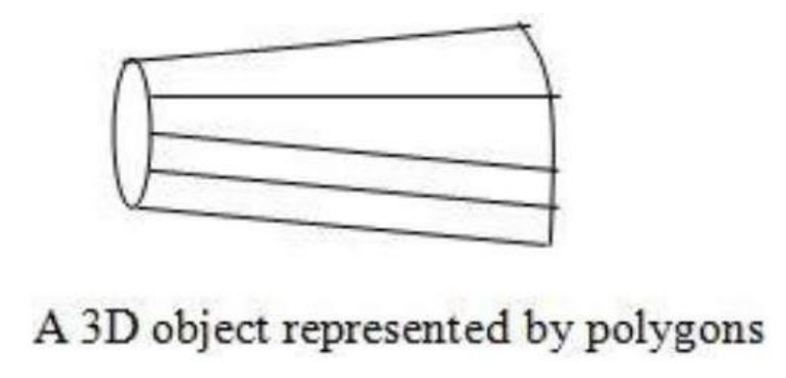
3d Object Représentation : Polygon Surfaces
The most commonly used representation for a 3D graphics object.
It is a set of surface polygons that enclose the object interior.

Slide 4
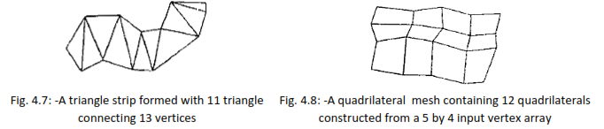
Polygon Mesh
Polygon mesh is a collection of edges, vertices and faces that define the shape of the polyhedral object in 3D graphics.
An edge can be shared by two or more polygons and vertex are shared by at least two edge.
A polygon surface can be thought of a surface composed of polygon faces.
Polygon mesh can be represented using following ways:
Explicit representation
Pointer to vertex list
Pointer to edge list

Slide 5
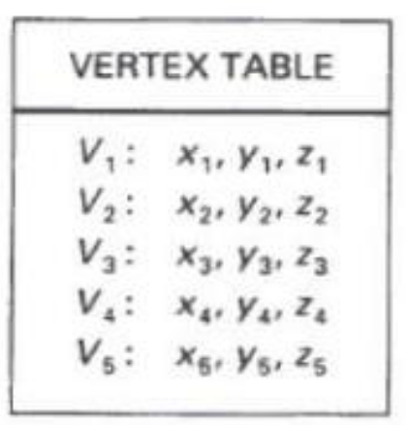
Explicit representation
In explicit representation each polygon stores all the vertices in order in the memory as,
P = (((x1,y1,z1),(x2,y2,z2),…, ((xm, ym, zm) (xn, yn, zn)))
It process fast but requires more memory for storing.
Pointer to vertex list
In this method each vertex stores in vertex list and then polygon contains pointer to the required vertex.
V = ((x1,y1,z1),(x2,y2,z2),…, (xn, yn, zn))
And now polygon of vertices is represented as 𝑃 = ( (v3,v4), (v4,v5), (v5,v6))
It is considerably space saving but common edges is difficult to find.

Slide 6
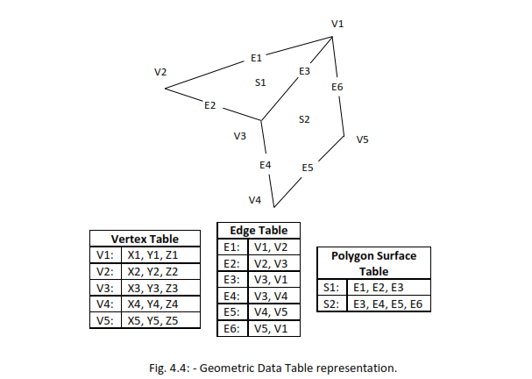
Pointer to edge list
In this polygon have pointers to the edge list and edge list have pointer to vertex list for each edge two vertex pointer is required which points in vertex list.
V = ((x1,y1,z1),(x2,y2,z2),…, (xn, yn, zn))
E = ( (v1,v2), (v2,v3), …, (vn,vm))
P= (E1, E2, …., En)
This approach is more memory efficient and easy to find common edges.

Slide 7
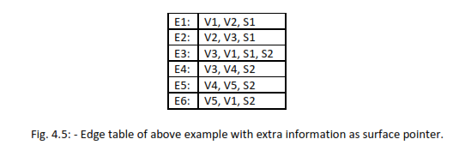
Since table have many entries for larger polygon, we need to check for consistency as it may be possible that errors may occur during input.
For dealing with that, we add extra information into the tables. For example, the figure below shows the edge table of above example with information of the surface in which the particular edge is present.
Now if any surface entry in polygon table will find edge in edge table it will verify whether this edge is of particular surface edge or not if not it detect an error and may be corrected, if sufficient information is added.

Slide 8
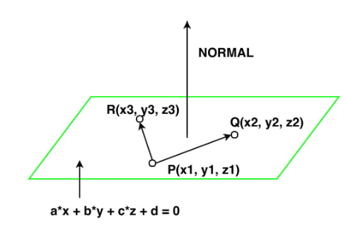
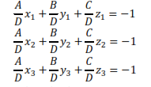
Plane equations
For producing display of 3D objects, we sometimes need to find out orientation and it can be obtained by vertex coordinate values and the equation of the plane given.
Equation of the plane is given as
Ax + By + Cz +D = 0
Let, three vertices of the plane are (x1 , y1 , z1 ), (x2 , y2 , z2 ) and (x3 , y3 , z3 ).
Where (x , y, z) is any point on the plane and A B C D are constants. By solving three plane equation for three non collinear points and solving the equation for ration of A/D, B/D, C/D as follows:

Slide 9
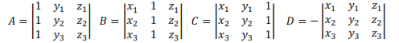
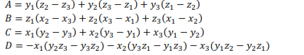
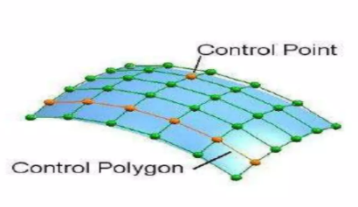
Solving these determinant
By expanding the determinant, we get
These values of A B C D are then stored in polygon data structure with other polygon data structure.

Slide 10
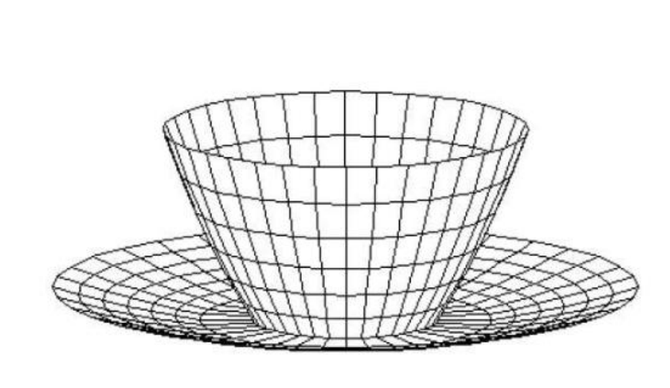
Linear Piecewise Approximation
representing a curved line using a series of connected straight line segments
that closely resembles the original curve

Slide 11
Polygon Meshes
Advantages
• It can be used to model almost any object.
• They are easy to represent as a collection of vertices.
• They are easy to transform.
• They are easy to draw on computer screen.
Disadvantages
• Curved surfaces can only be approximately described.
• It is difficult to simulate some type of objects like hair or liquid.

Slide 12
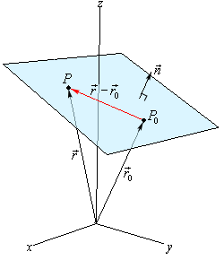
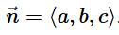
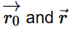
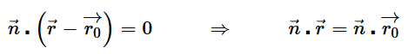
Plane orientation is described with normal vector to the plane
A point that is on the plane, P0=(x₀,y0,z0)
Let’s also suppose that we have a vector that is orthogonal (perpendicular) to the plane
This vector is called the normal vector.
Now, assume that P=(x,y,z) is any point in the plane.
Finally, since we are going to be working with vectors initially we’ll
Let ,
be the position vectors for P₀ and P respectively.
Here is a sketch of all these vectors.
Notice that we added in the vector which will lie completely in the plane.
The Dot Product of two orthogonal vectors will have a zero.

Slide 13
Curves and surfaces
have explicit, implicit, and parametric representations.
Parametric representations of cubic curves
x = x(t), y = y(t), z = z(t)
The curve Q(t) is defined as
Q(t) = [x(t) y(t) z(t)]
Q(t) = T ·C
Q’(t) - the 1st order derivative of Q(t)
is the parametric tangent vector (the velocity of a point)
The curve is approximated by a piecewise polynomial curve instead of a piecewise linear curve.
Flexibility in controlling the shape of the curve.

Slide 14
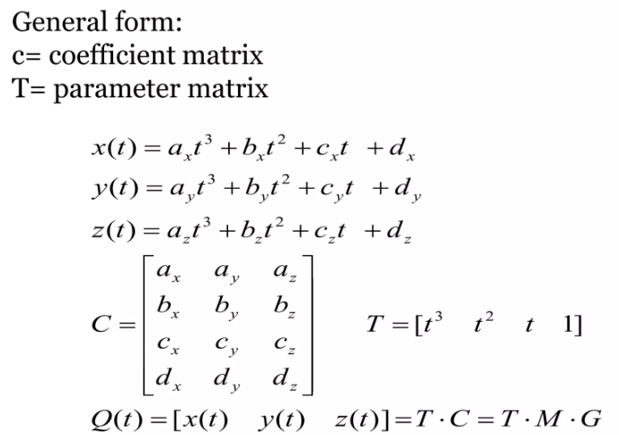
Parametric Cubic Curves
We can express Q(t) as the product Q(t) = T · C
Where, 0 < t < 1
C = M. G
The derivatives of the curve with respect to t can be expressed as follows:
x'(t) = [3t^2 2t 1 0] A

Slide 15
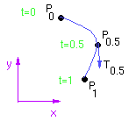
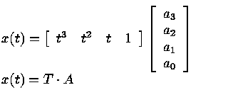
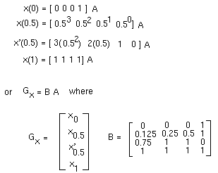
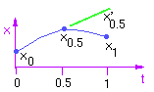
Example: Suppose define a cubic curve with two endpoints and a midpoint,
as well as the tangent at the midpoint.
The following figure illustrates some sample curves.
We'll first construct the cubic curve for x(t).
There are four constraints that are to be met and four unknowns:
A compact version of the parametric equations can be written as follows:
Similarly, we can write
y(t) = T . B
z(t) = T . C

Slide 16
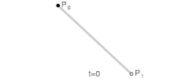
Linear curves
Let t denote the fraction of progress (from 0 to 1) the point B(t) has made along its traversal from P₀ to P₁.
For example, when t=0.25, B(t) is one quarter of the way from point P₀ to P₁.
As t varies from 0 to 1, B(t) draws a line from P₀ to P₁.
Animation of a linear Bézier curve, t in [0,1]

Slide 17
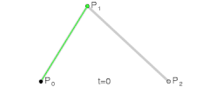
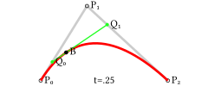
Quadratic curves
For quadratic Bézier curves one can construct intermediate points Q₀ and Q₁ such that as t varies from 0 to 1:
Point Q₀(t) varies from P₀ to P₁ and describes a linear Bézier curve.
Point Q₁(t) varies from P₁ to P₂ and describes a linear Bézier curve.
Point B(t) is interpolated linearly between Q₀(t) to Q₁(t) and describes a quadratic Bézier curve.
Construction of a quadratic Bézier curve |  | Animation of a quadratic Bézier curve, t in [0,1]

Slide 18
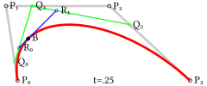
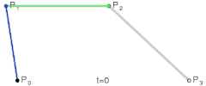
Higher-order curves
For higher-order curves one needs correspondingly more intermediate points.
For cubic curves one can construct intermediate points Q₀, Q₁, and Q₂ that describe linear Bézier curves, and points R₀ and R₁ that describe quadratic Bézier curves:
Construction of a cubic Bézier curve |  | Animation of a cubic Bézier curve, t in [0,1]

Slide 19
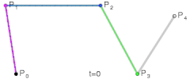
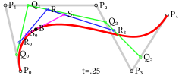
fourth-order curves
Construction of a quartic Bézier curve |  | Animation of a quartic Bézier curve, t in [0,1]

Slide 20
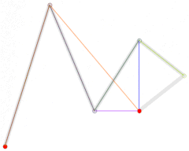
fifth-order curves

Slide 21
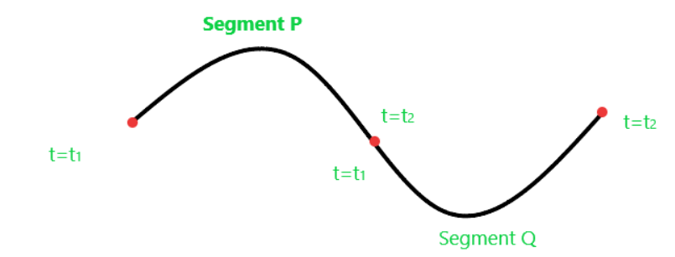
Geometric and Parametric Continuity (two curve segments)
Parametric Continuity
C⁰: curves are joined
C¹: first derivatives equal
C²: first and second derivatives are equal If t is taken to be time, this implies that the acceleration is continuous.
C^{n}: nth derivatives are equal
As their names imply, geometric continuity requires the geometry to be continuous, while parametric continuity requires that the underlying parameterization be continuous as well. Parametric continuity of order n implies geometric continuity of order n, but not vice-versa.

Slide 22
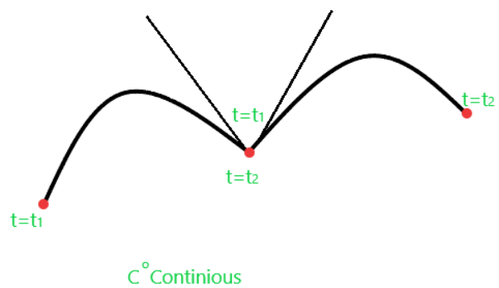
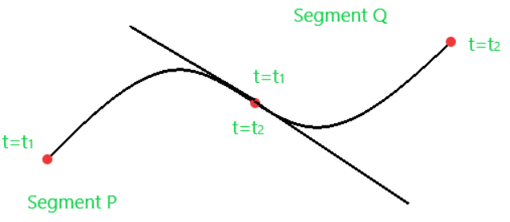
C⁰: curves are joined
• Segments have to match ‘nicely’.
If both segments of the curve intersect at one endpoint.
i.e. (x,y,z) values of both curves agree.
P(t₂) = Q(t₁)
First-order parametric continuity(C¹)
if it is Cº Continuous (x,y,z) values agree
and the first-order derivatives agree
(the tangent vectors have same direction and magnitude)
→ →
TV₁ = TV₂
P’(t₂) = Q’(t₁)
P’(1) = Q’(0)

Slide 23
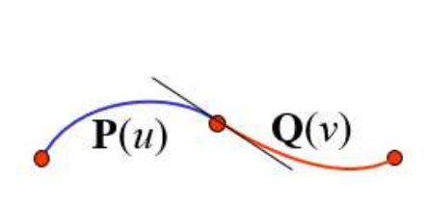
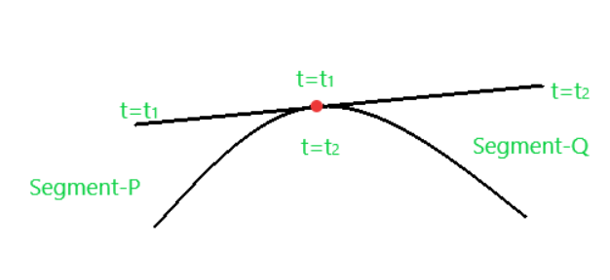
Second-order parametric continuity(C²)
if it is Cº and C¹ Continuous
the second-order derivative of the segment P at t=t₁ is equal to the second-order derivative of segment Q at t=t₂.
C 2 : d²P(1)/du² = d²Q(0)/dv² .
Curvatures in P(1) and Q(0) are equal.
P’’(t₂) = Q’’(t₁)

Slide 24
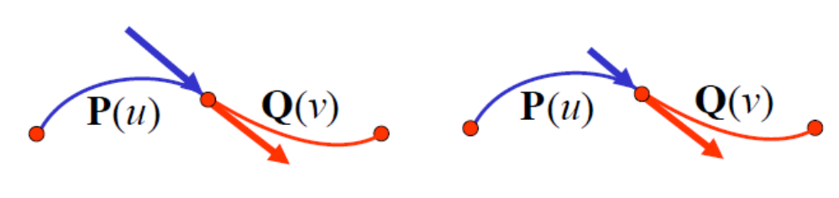
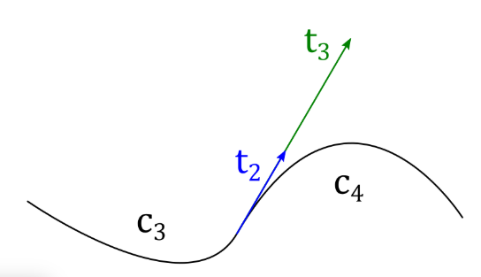
Geometric Continuity
It suffices to require that the directions are the same:
If G⁰: curves are joined
( Same as zero order parametric continuity)
G¹: first derivatives are proportional at the join point
The curve tangents TV₁ and TV₂ thus have the same direction, but not necessarily the same magnitude.
i.e., TV₁ = K * TV₂
(In parametric continuity these are equal)
G²: first and second derivatives are proportional at join point
G¹ Continuity

Slide 25
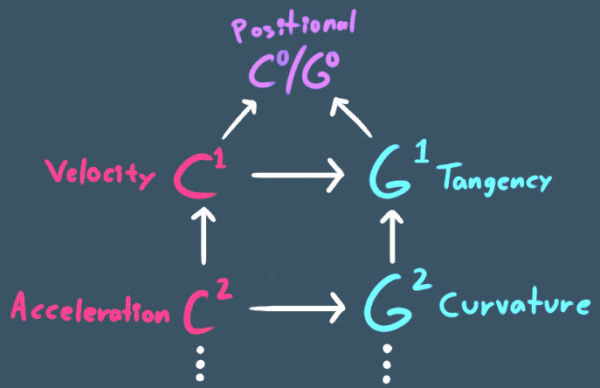

Slide 26
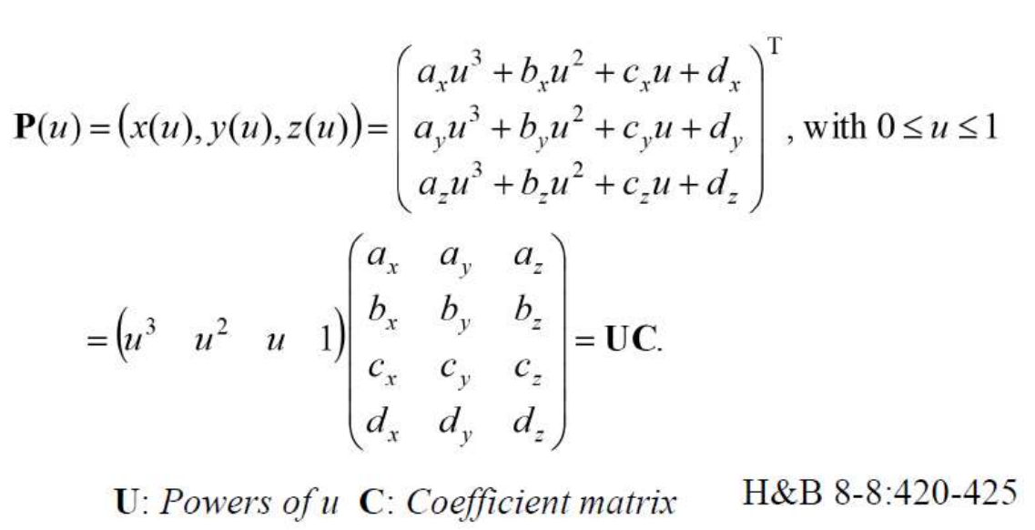
Spline Representation
Spline is flexible strip used to produce a smooth curve through a designated set of points.
There are three equivalent methods for specifying a particular spline representation:
We can state :
the set of boundary conditions that are imposed on the spline;
the matrix that characterizes the spline;
the set of blending functions
boundary conditions
the endpoint coordinates x(0) and x(1) and on the parametric first derivatives at the endpoints x'(0) and x '(1).

Slide 27
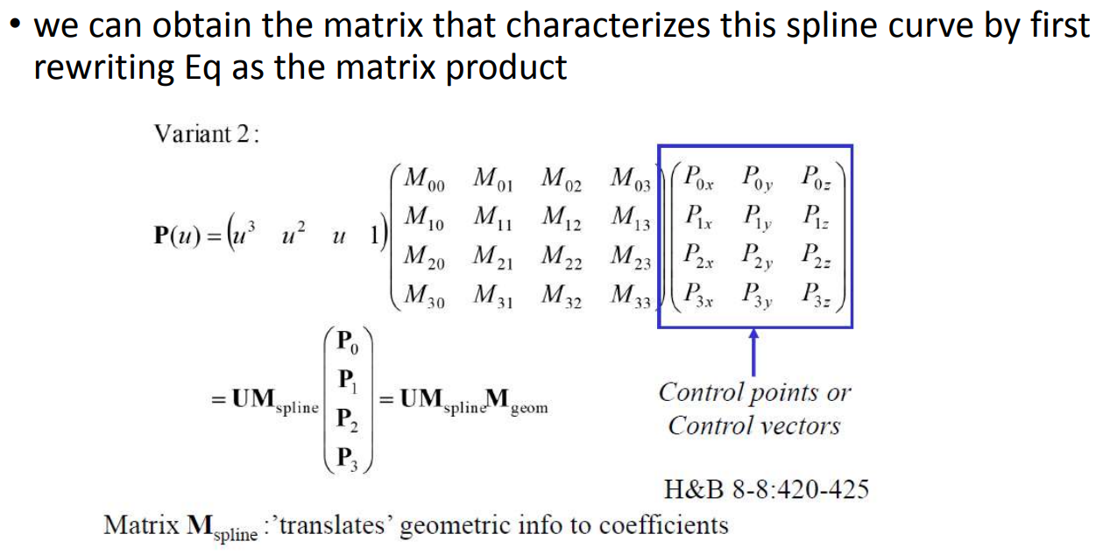
Matrix Form

Slide 28
Difference
 | Hermite Spline | Bezier Curve
Control Point | Uses two endpoints and two tangent vectors at those endpoints to define the curve. | Uses a set of control points, where the first and last points are on the curve and the intermediate points influence its shape.
Tangents | Explicitly specifies the tangents at each endpoint, providing precise control over the curve's direction at those points. | Tangents are implicitly determined by the placement of control points, offering less direct control over the curve's tangents.
Mathematical Basis | Uses Hermite polynomials to construct the curve. | Uses Bernstein polynomials to define the curve.

Slide 29
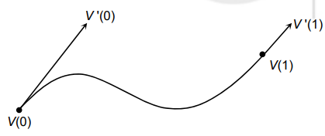
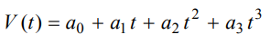
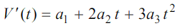
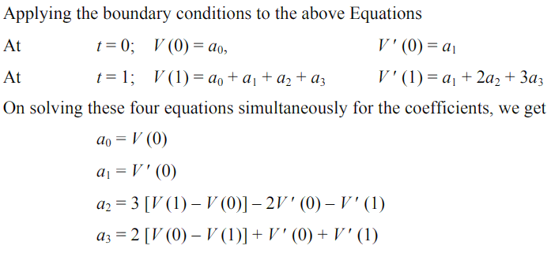
Hermite Cubic Spline
The general form of a cubic function can be written as;
0 < t < 1.

Slide 30
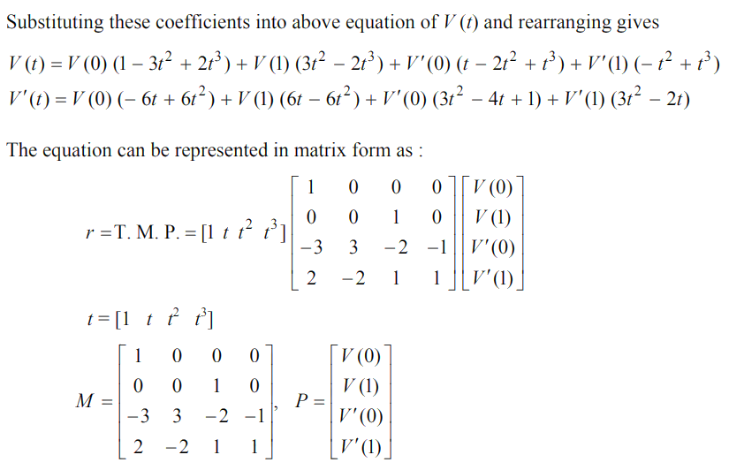

Slide 31
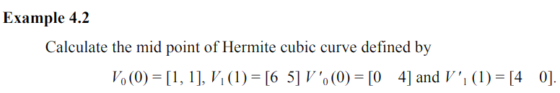
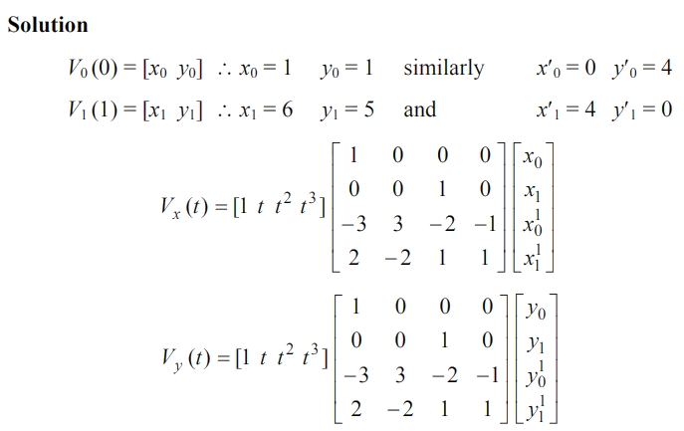
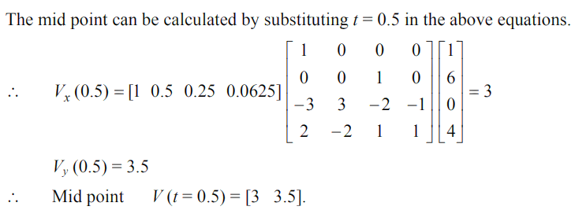

Slide 32
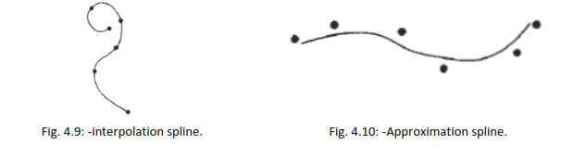
Interpolation spline
We specify spline curve by giving a set of coordinate positions called control points. This indicates the general shape of the curve.
Interpolation Spline:
When curve section passes through each control point, the curve is said to interpolate the set of control points and that spline is known as Interpolation Spline.

Slide 33
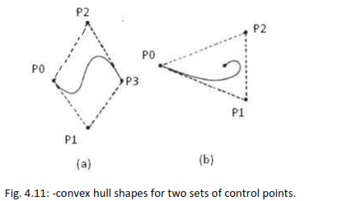
Approximation Spline: -
When curve section follows general control point path without necessarily passing through any control point, the resulting curve is said to approximate the set of control points and that curve is known as Approximation Spline.
The convex polygon boundary that encloses a set of control points is called convex hull.

Slide 34
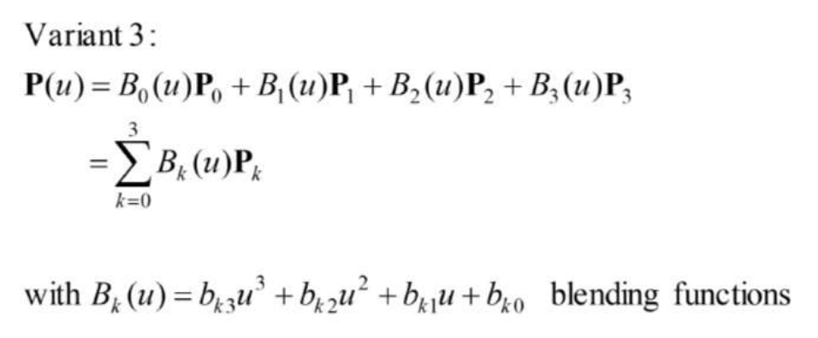
blending functions

Slide 35
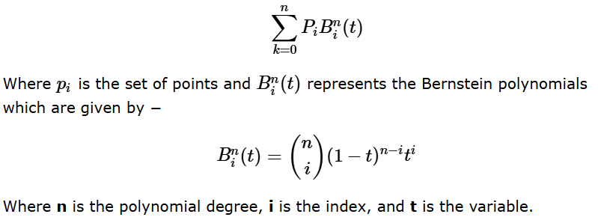

Bezier Curves
Bezier curve is discovered by the French engineer Pierre Bézier.
The Bezier curve can be represented mathematically as −

Slide 36
Bezier Curves
It is developed by French engineer Pierre Bezier for the Renault automobile bodies.
Bezier curve section can be fitted to any number of control points.
Number of control points and their relative position gives degree of the Bezier polynomials.
With the interpolation spline Bezier curve can be specified with boundary condition or blending function.
Most convenient method is to specify Bezier curve with blending function.
Consider, we are given N+1 control point position from P0 to Pn where Pk = (Xk, Yk, Zk)
This is blended to give position vector p(u) which provides path of the approximate Bezier curve.
Bezier curve is a polynomial of degree one less than the number of control points used.

Slide 37




Cubic Bezier curve has n = 3
Bezier polynomial function between P₀ and P_{n}
The Bezier blending functions are the Bernstein polynomials.
Where the C(n, k) are the binomial coefficients:

Slide 38


Slide 39

Below figure shows some possible curve shapes by selecting various control point.
Efficient method for determining coordinate positions along a Bezier curve can be set up using recursive calculation

Slide 40
Properties of Bezier curve
It always passes through first control point i.e. p(0) = p₀
It always passes through last control point i.e. p(1) = p_{n}
Parametric first order derivatives of a Bezier curve at the endpoints can be obtained from control point coordinates as:
P’(0) = -nP₀ + nP₁
P’(1) = -nP_{n-1} + n P_{n}
always lies within the convex hull of the control points.
Bezier blending function is always positive.
smoothly follows the control points without erratic oscillations.

Slide 41

Designing for Bezier curve
For obtaining closed Bezier curve we specify first and last control point at same position.
If we specify multiple control point at same position it will get more weight and curve is pull towards that position.
Since Bezier curve passes through first and last control point it is easy to join two curve sections with zero order parametric continuity (C0).
For first order continuity we put end point of first curve and start point of second curve at same position and last two points of first curve and first two point of second curve is collinear.
So that control points are equally spaced.

Slide 42


B-spline
In the B-spline curve, the control points impart local control over the curve-shape rather than the global control like Bezier-curve. B-spline curve shape before changing
the position of control point P₁ –
B-spline curve shape after changing
the position of control point P₁ –

Slide 43
B Splines
B-splines automatically take care of continuity, with exactly one control vertex per curve segment
Many types of B-splines: degree may be different (linear, quadratic, cubic,…)
and they may be uniform or non-uniform
We will only look closely at uniform B-splines
With uniform B-splines, continuity is always one degree lower than the degree of each curve piece
Linear B-splines have C⁰ continuity, cubic have C², etc

Slide 44

B-spline curves
B-Spline is most widely used approximation spline.
It has two advantage over Bezier spline
1. Degree of a B-Spline polynomial can be set independently of the number of control points 2. B-Spline allows local control.
Disadvantage of B-Spline curve is more complex than Bezier spline
General expression for B-Spline curve in terms of blending function is given by:

Slide 45

Knots - These are points along a B-spline curve where the curve sections meet and connect.
All B-splines have at least two knots, which will define the end points of the B-spline curve.
There are three general classification for knot vectors:
o Uniform
o Open uniform
o Non uniform

Slide 46
Properties of B-Spline curve
It has degree d-1 and continuity C^{d-2} over range of u.
For n+1 control point we have n+1 blending function.
Each blending function 𝐵_{𝑘,𝑑}(𝑢) is defined over d subintervals of the total range of u, starting at knot value u_{k}.
The range of u is divided into n+d subintervals by the n+d+1 values specified in the knot vector.
With knot values labeled as {𝑢₀, u₁, …, u_{n+d}} the resulting B-Spline curve is defined only in interval from knot values 𝑢𝑑-1 up to knot values 𝑢_{𝑛+1}
Each spline section is influenced by d control points.
Any one control point can affect at most d curve section.

Slide 47

Parametric Bicubic Surfaces
goal is curved surfaces in space.
To do this, we will parameterize a surface in terms of two free parameters, s & t
Start by fitting 4 cubic curves, corresponding to s = 0, 1, 2, 3
Then, for each t, fit a cubic curve as a function of s.

Slide 48



The solution
and similarly for y(s,t) and z(s,t)
For each s = 0, 1, 2, 3

Slide 49


Now, For any t, we fit a cubic of parameter s

Slide 50



Surface tangents and surface normals
Any linear combination of these is a tangent.

Slide 51

In 3D

